Slide 1
Lesson 5: Relational Data Model &
Relational Database Constraints
CSC430/530 – DATABASE MANAGEMENT SYSTEMS

Slide 2
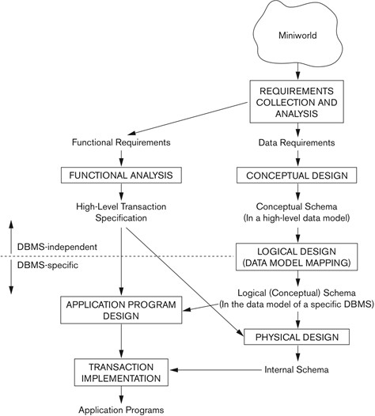
OUTLINE
Relational model concepts.
Characteristics of relations.
Relational model constraints.
Operations & constraints violations.

Slide 3
RELATIONAL MODEL CONCEPTS: INTRO
Relational model represents the database as a collection of relations.
Relation looks like a table of values:
Table name.
Describes the meaning of the relation.
Column header.
Indicates the meaning of the data items in that column.
Formally – attribute.
Row.
Collection of related data values.
Represents certain facts that correspond to a real-world entity or relationship.
Formally – tuple.
Domain.
Data type describing the types of values that can appear in each column.

Slide 4
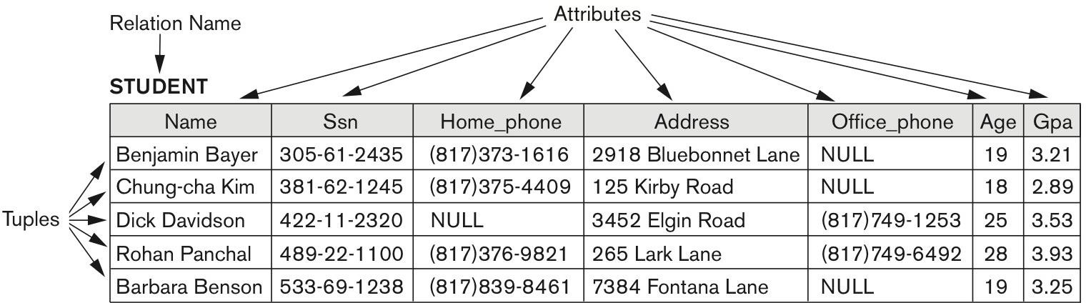
RELATIONAL MODEL CONCEPTS: EXAMPLE
Example of STUDENT relation.
Attributes - Name, Ssn, Home_phone, Address, Office_phone, Age, Gpa.
Attributes and tuples of STUDENT relation

Slide 5
RELATIONAL MODEL CONCEPTS: SCHEMA
Schema (description) of a relation is denoted by R(A₁, A₂, ... , A_{n}), where:
R – name of the relation;
A₁, A₂, ... , A_{n} – list of attributes of the relation.
A_{i} – name of the role played by attribute in the relational schema R.
Example:
CUSTOMER (CID, CName, Address, Phone#)
CUSTOMER is the relation name defined over the four attributes: CID, CName, Address, Phone#.

Slide 6
RELATIONAL MODEL CONCEPTS: TUPLE
Tuple is an ordered set of values.
Enclosed in angled brackets ‘<…>’.
Each value is derived from an appropriate domain.
Relation is a set of tuples.
Example:
A row in the CUSTOMER relation consists of four values:
<632895, "John Smith", "101 Main St. Atlanta, GA 30332", "(404)894-2000">
This is called a 4-tuple of the CUSTOMER relation.

Slide 7
RELATIONAL MODEL CONCEPTS: DOMAIN
Domain D is a set of atomic values.
Atomic values are indivisible.
Domain specifies data type and format for an attribute.
“Phone#” has a format: (ddd)ddd-dddd where each d is a decimal digit.
In addition, domain provides a logical definition.
“Phone#” is the set of 10-digit phone numbers valid in the U.S.
Domain role in a relation is designated by the attribute name.
Interprets the meaning of the data elements corresponding to that attribute.
The domain “Phone#” may be used to define two attributes - “Home-phone” and “Work-phone”.

Slide 8
RELATIONAL MODEL CONCEPTS: STATE
Relation state r of the relation schema R(A₁, A₂, … , A_{n}) is denoted by r(R).
Set of n-tuples r = {t₁, t₂, … , t_{m}}.
Each n-tuple t is an ordered list of n values, t = <v₁, v₂, … , v_{n}>.
Each value v_{i} is an element of dom(A_{i}) or a NULL value.
Attributes and tuples of STUDENT relation

Slide 9
RELATIONAL MODEL CONCEPTS: SUMMARY
R(A₁, A₂, … , A_{n}) - schema of the relation.
R - name of the relation.
A₁, A₂, … , A_{n} - attributes of the relation.
r(R) = {t₁, t₂, …, t_{m}} - state of the relation R.
t_{i} = <v₁, v₂, … , v_{n}> - n-tuple of the state.
v_{j} - element of dom(A_{j}).
Informal Terms |  | Formal Terms
Table | = | Relation
Column Header | = | Attribute
All possible Column Values | = | Domain
Row | = | Tuple
Table Definition | = | Schema of the Relation
Populated Table | = | State of the Relation

Slide 10
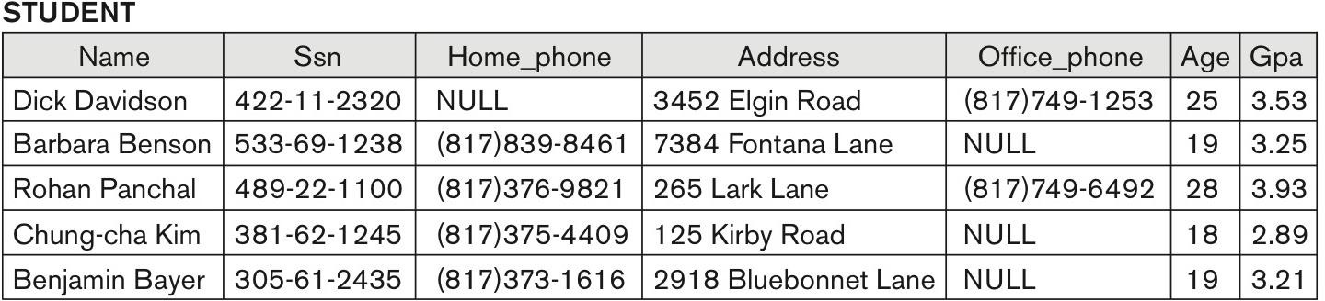
CHARACTERISTICS OF RELATIONS (1)
Ordering of tuples in a relation r(R).
Relation is defined as a set of tuples.
The tuples are not ordered.
Ordering of attributes in a relation schema R.
Attributes in R(A₁, A₂, ..., A_{n}) and the values in t = <v₁, v₂, ..., v_{n}> are ordered.
Alternatively, tuple can be represented as a set of {<attribute>, <value>} pairs.
t = {<name, “John” >, <SSN, 123456789>}.
Relation STUDENT with different order of tuples

Slide 11
CHARACTERISTICS OF RELATIONS (2)
Values in a tuple.
All values are considered atomic (indivisible).
Composite and multivalued attributes are not allowed.
Each value in a tuple must be from the domain of the attribute for that column.
A special NULL value is used when:
Value is unknown;
Value exists, but is not available;
Value is undefined.

Slide 12
RELATIONAL MODEL CONSTRAINTS
Relational model constraints are restrictions on actual values in a database state.
Derived from the rules of database mini-world.
Three main types of constraints:
Inherent (implicit) constraints.
Expressed as the characteristics of the relations.
Schema-based (explicit) constraints.
Directly expressed in the schemas of the data model.
Application-based (semantic) constraints.
Expressed and enforced by the application programs.
In addition, there are data dependencies (functional & multivalued).
For testing the “goodness” of the design of a relational database.
Utilized during normalization process.

Slide 13
SCHEMA-BASED CONSTRAINTS
Schema-based constraints include:
Domain constraint.
Key constraint.
Entity integrity constraint.
Referential integrity constraint.

Slide 14
SCHEMA-BASED CONSTRAINTS: DOMAIN
Domain constraint - the value of an attribute A within tuple must be an atomic value from the
domain dom(A).
Typical data types:
Numeric data types for integers and real numbers.
Characters.
Booleans.
Fixed-length and variable-length strings.
Date, time, timestamp.
Currency.
Other special data types.

Slide 15
SCHEMA-BASED CONSTRAINTS: KEY (1)
Key constraint - no two tuples can have the same combination of values for all their attributes.
Uniqueness constraint.
Superkey (SK) of R.
Set of attributes SK of R with the following condition:
No two tuples in any valid relation state r(R) have the same value for SK.
For any distinct tuples t₁ and t₂ in r(R), t₁[SK] ≠ t₂[SK].
Key of R.
A "minimal" superkey.
Removal of any attribute from key results in a set of attributes that is NOT a superkey anymore.
Satisfies two properties:
Two distinct tuples in any state of the relation cannot have identical values for (all) the attributes in the key.
Cannot remove any attributes and still have the uniqueness constraint to hold.

Slide 16
SCHEMA-BASED CONSTRAINTS: KEY (2)
Example:
STUDENT relation schema:
STUDENT(Name, Ssn, Home_phone, Address, Office_phone, Age, Gpa)
Attribute set {Ssn} is a key.
No two students can have the same value for SSN.
Any set of attributes that includes Ssn is a superkey, but not a key.
{Name, Ssn, Age}.
{Ssn, Age, Gpa}.

Slide 17
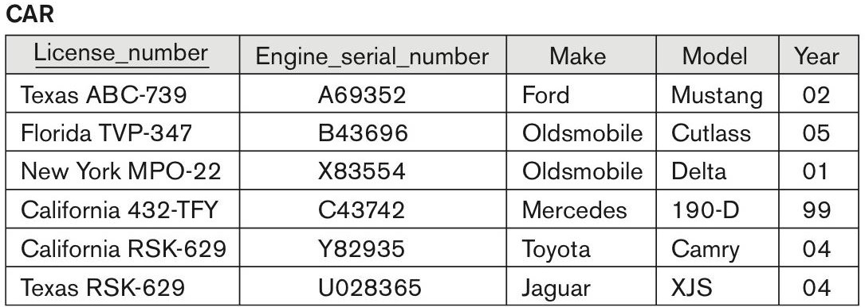
SCHEMA-BASED CONSTRAINTS: KEY (3)
If a relation has several candidate keys, one is chosen arbitrarily to be the primary key.
The primary key attributes are underlined.
Value of primary key is used to:
Uniquely identify each tuple in a relation.
Reference the tuple from another tuple.
CAR relation with two candidate keys

Slide 18
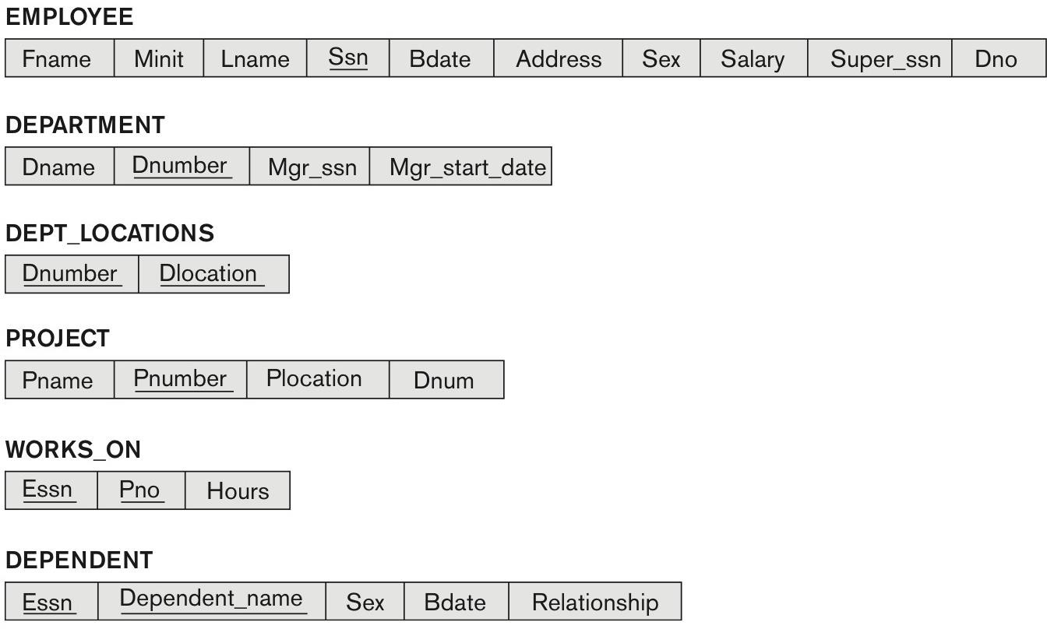
RELATIONAL DATABASE SCHEMA
Relational database schema:
Set of relation schemas S = {R₁, R₂, ..., R_{n}}.
R₁, R₂, … , R_{n} are the names of the individual relation schemas within the database S.
Represents set of integrity constraints.
COMPANY relational database schema

Slide 19
RELATIONAL DATABASE STATE (1)
Relational database state (snapshot):
Set of relation states DB = {r₁, r₂, ..., r_{m}}.
Each r_{i} is a state of R_{i}, such that the r_{i} relation states satisfy the integrity constraints specified in relational schema.
Valid state satisfies all the integrity constraints.
Invalid state does not satisfy the integrity constraints.

Slide 20
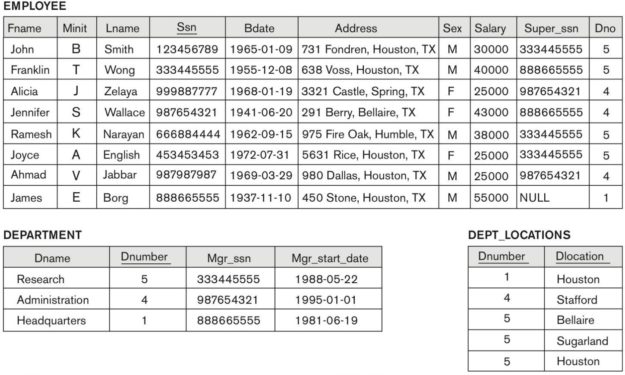
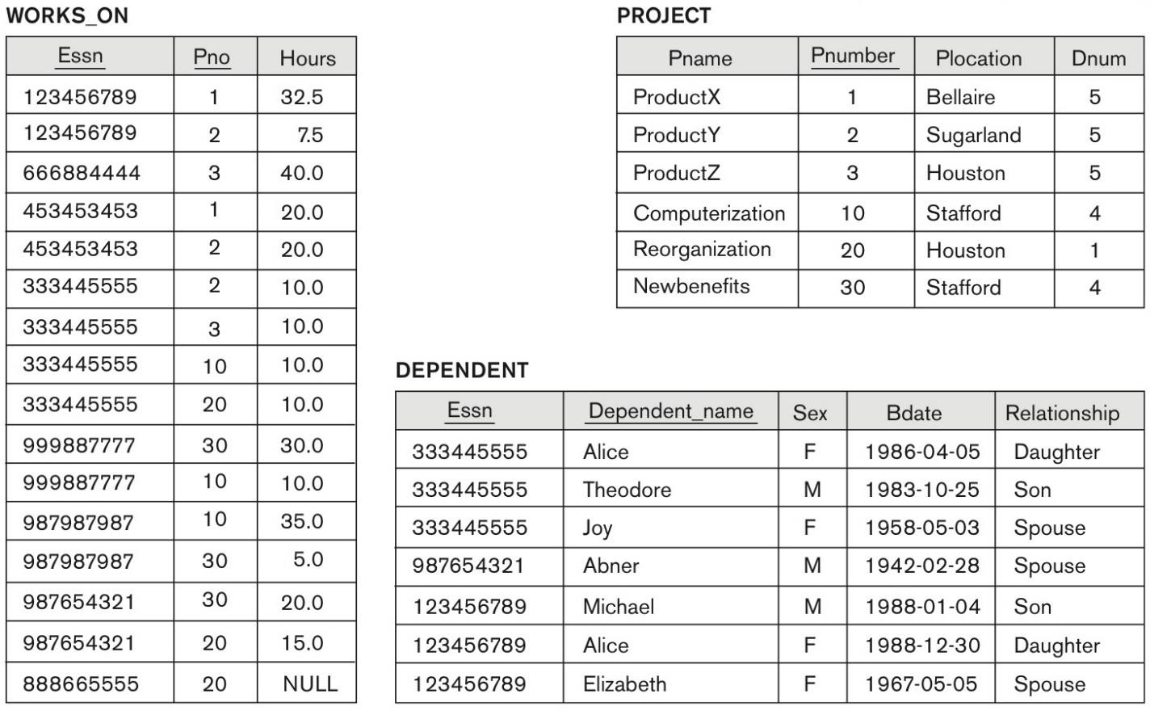
RELATIONAL DATABASE STATE (2)
Example of populated state of COMPANY database.
State of COMPANY relational database schema

Slide 21
SCHEMA-BASED CONSTRAINTS: ENTITY INTEGRITY
Entity integrity constraint – primary key attributes PK of each relation schema R in database
schema S cannot have NULL values in any tuple of r(R).
t[PK] ≠ NULL for any tuple t in r(R).
If PK has several attributes, NULL is not allowed in any of these attributes
Other attributes of R may be constrained to disallow NULL values.
Even if not members of the primary key.

Slide 22
SCHEMA-BASED CONSTRAINTS: REFERENTIAL INTEGRITY (1)
Referential integrity constraint is used to specify a relationship among tuples in two relations.
Referencing relation R₁ and referenced relation R₂.
Tuples in R₁ have foreign key attributes FK that reference the primary key attributes PK of R₂.
A tuple t₁ in R₁ is said to reference a tuple t₂ in R₂ if t₁[FK] = t₂[PK].
Foreign key rule:
The value of the FK in the referencing relation R₁ can either be a value of an existing PK in the
referenced relation R₂, or NULL.

Slide 23
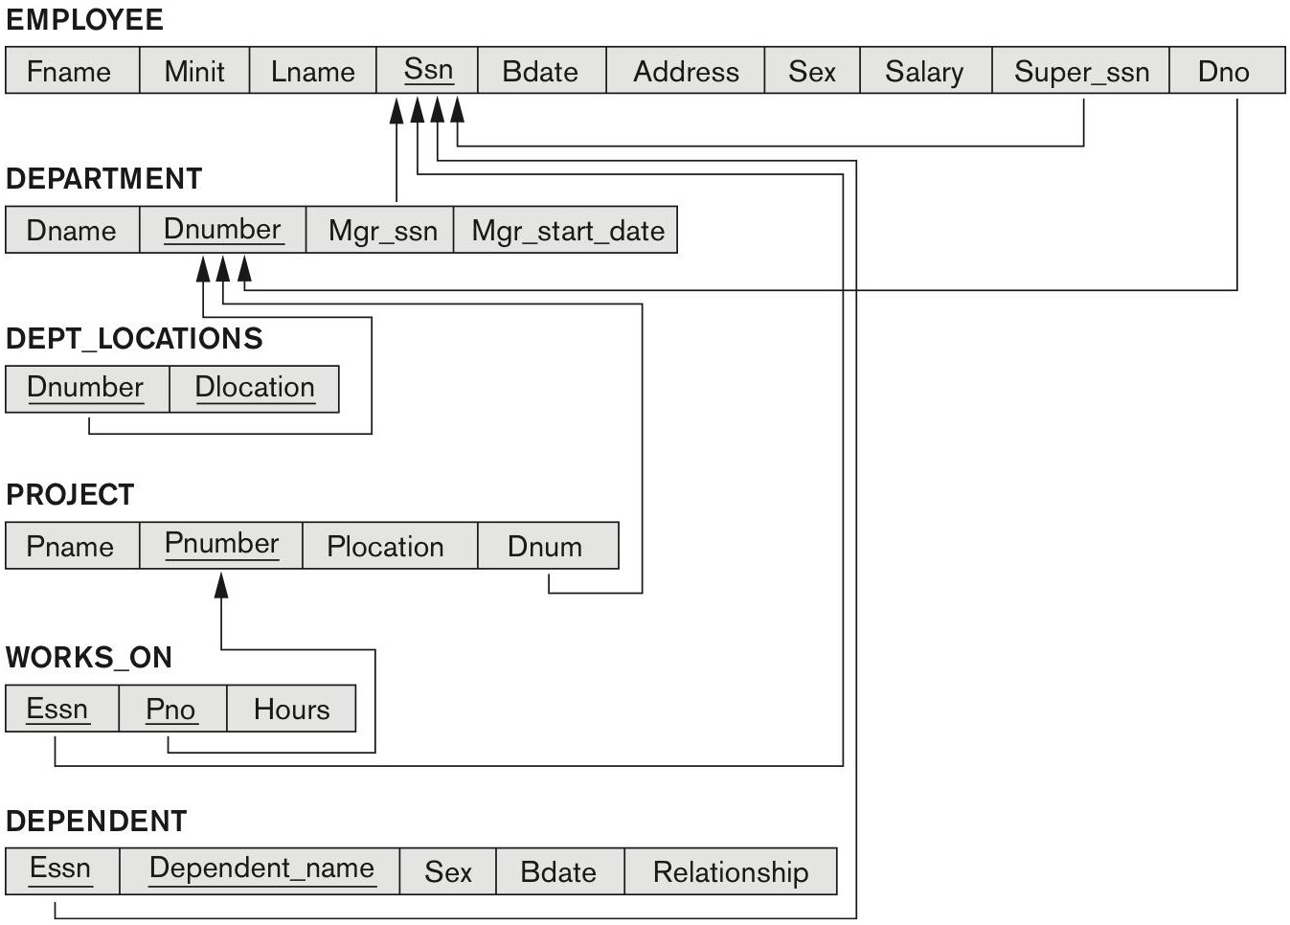
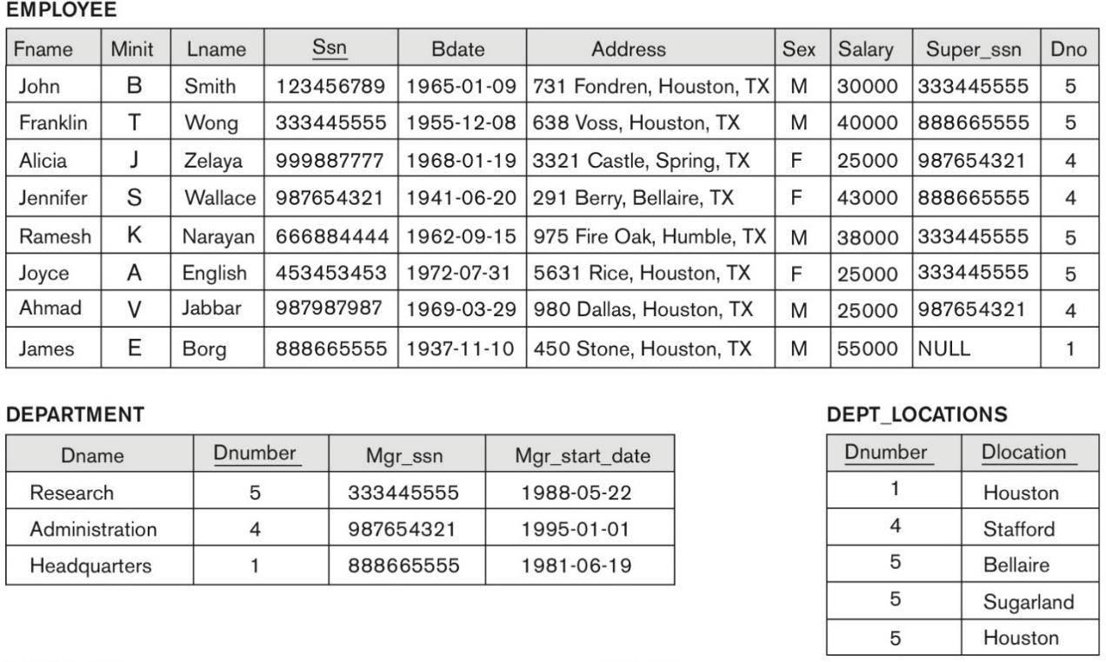
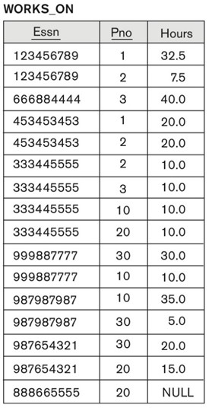
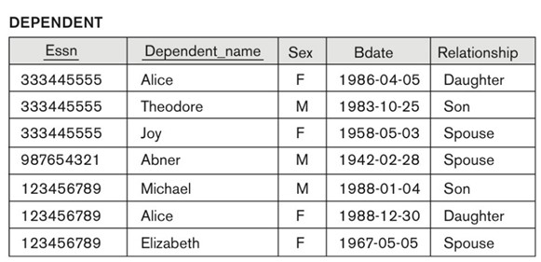
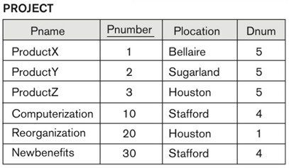
SCHEMA-BASED CONSTRAINTS: REFERENTIAL INTEGRITY (2)
Referential integrity constraints
Database state

Slide 24
OPERATIONS & CONSTRAINTS VIOLATIONS
Operations of relational model:
Retrievals.
Updates.
Insert a tuple.
Delete a tuple.
Modify a tuple.
Update (modification) operations change the state of the relations in database and can violate
schema-based constraints.

Slide 25
OPERATIONS: INSERT (1)
Provides a list of attribute values for a new tuple t that is to be inserted into a relation R.
Insert operation can violate any of the four constraints:
Domain constraint.
If one of the attribute values provided for the new tuple is not of the specified attribute domain.
Key constraint.
If the value of a key attribute in the new tuple already exists in another tuple in the relation.
Entity integrity.
If the primary key value is NULL in the new tuple
Referential integrity.
If a foreign key value in the new tuple references a primary key value that does not exist in the referenced relation.
In case of violation the default option is to reject the insertion.

Slide 26
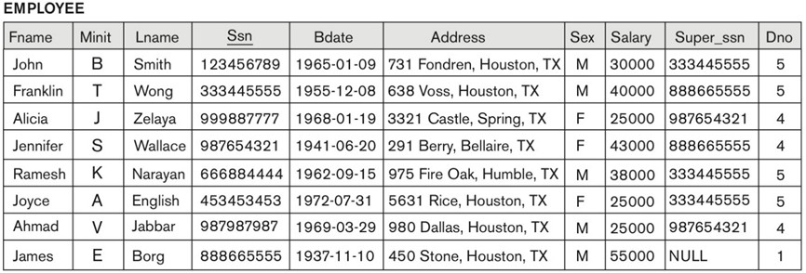
OPERATIONS: INSERT (2)
Examples:
Insert <‘Cecilia’, ‘F’, ‘Kolonsky’, NULL, ‘1960-04-05’, ‘6357 Windy Lane, Katy, TX’, F, 28000, NULL, 4>
into EMPLOYEE.
Insert <‘Alicia’, ‘J’, ‘Zelaya’, ‘999887777’, ‘1960-04-05’, ‘6357 Windy Lane, Katy, TX’, F, 28000, ‘987654321’, 4>
into EMPLOYEE.

Slide 27
OPERATIONS: INSERT (2)
Examples:
Insert <‘Cecilia’, ‘F’, ‘Kolonsky’, NULL, ‘1960-04-05’, ‘6357 Windy Lane, Katy, TX’, F, 28000, NULL, 4>
into EMPLOYEE.
Violates entity integrity constraint (NULL for the primary key Ssn) → rejected.
Insert <‘Alicia’, ‘J’, ‘Zelaya’, ‘999887777’, ‘1960-04-05’, ‘6357 Windy Lane, Katy, TX’, F, 28000, ‘987654321’, 4>
into EMPLOYEE.
Violates key constraint (another tuple with the same Ssn exists in the EMPLOYEE) → rejected.

Slide 28
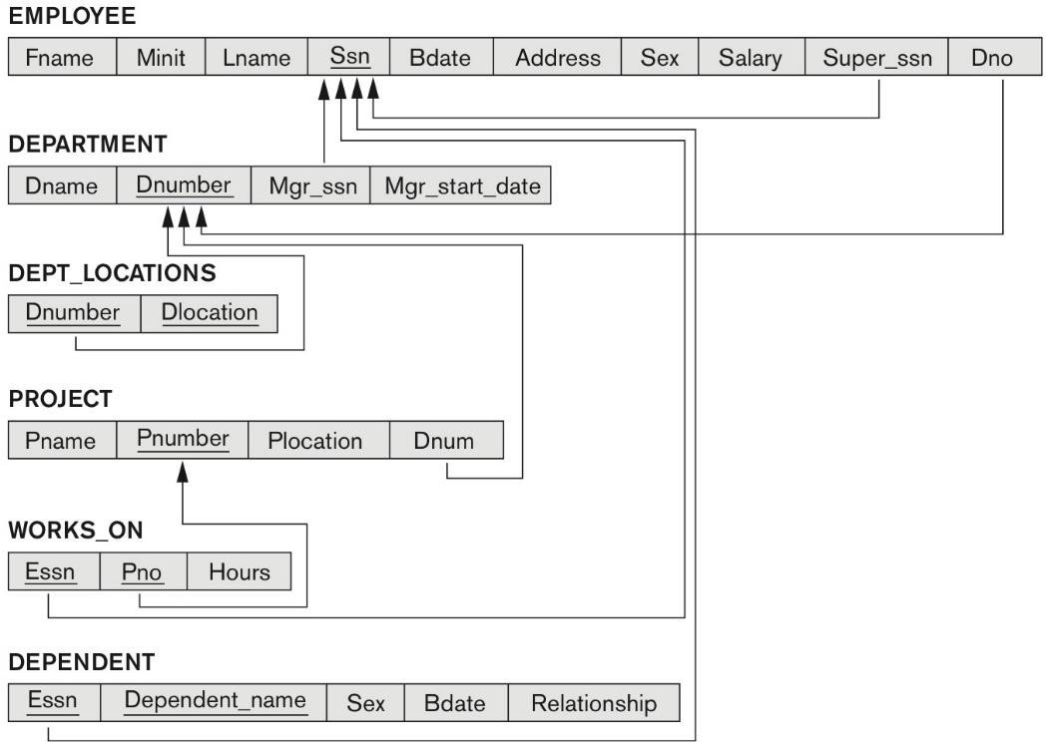
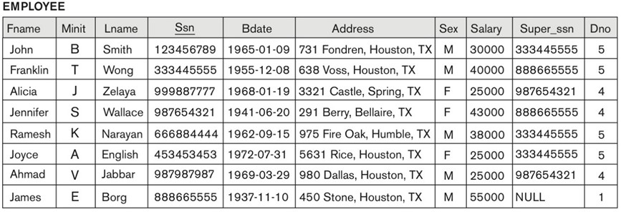
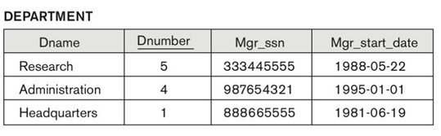
OPERATIONS: INSERT (3)
Examples:
Insert <‘Cecilia’, ‘F’, ‘Kolonsky’, ‘677678989’, ‘1960-04-05’, ‘6357 Windswept, Katy, TX’, F, 28000, ‘987654321’, 7>
into EMPLOYEE.
Insert <‘Cecilia’, ‘F’, ‘Kolonsky’, ‘677678989’, ‘1960-04-05’, ‘6357 Windy Lane, Katy, TX’, F, 28000, NULL, 4>
into EMPLOYEE.

Slide 29
OPERATIONS: INSERT (3)
Examples:
Insert <‘Cecilia’, ‘F’, ‘Kolonsky’, ‘677678989’, ‘1960-04-05’, ‘6357 Windswept, Katy, TX’, F, 28000, ‘987654321’, 7>
into EMPLOYEE.
Violates referential integrity constraint specified on Dno in EMPLOYEE (no tuple in DEPARTMENT with Dnumber = 7) →
rejected.
Insert <‘Cecilia’, ‘F’, ‘Kolonsky’, ‘677678989’, ‘1960-04-05’, ‘6357 Windy Lane, Katy, TX’, F, 28000, NULL, 4>
into EMPLOYEE.
Satisfies all constraints → accepted.

Slide 30
OPERATIONS: DELETE (1)
Can only violate referential integrity.
Tuple being deleted is referenced by foreign keys from other tuples in the database.
Can be handled by:
Restrict.
Reject the deletion.
Cascade.
Delete the tuples referenced by the foreign key.
Set NULL.
Set the foreign keys of the referencing tuples to NULL.

Slide 31
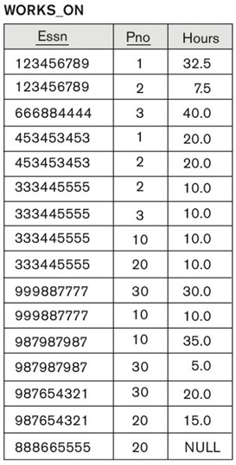
OPERATIONS: DELETE (2)
Examples:
Delete EMPLOYEE tuple with Ssn = ‘999887777’.

Slide 32
OPERATIONS: DELETE (2)
Examples:
Delete EMPLOYEE tuple with Ssn = ‘999887777’.
Not acceptable, because there are tuples in WORKS_ON relation that refer to this tuple.
Deletion will result in referential integrity constraint violations.

Slide 33
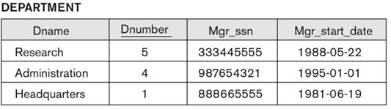
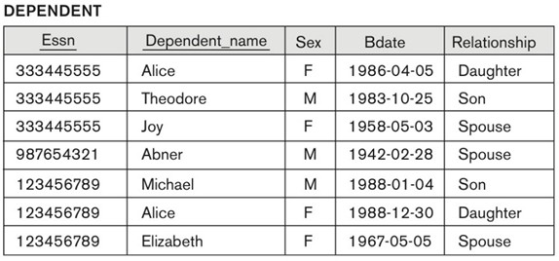
OPERATIONS: DELETE (3)
Examples:
Delete EMPLOYEE tuple with Ssn = ‘333445555’.
Delete WORKS_ON tuple with Essn = ‘999887777’ and Pno = 10.

Slide 34
OPERATIONS: DELETE (3)
Examples:
Delete EMPLOYEE tuple with Ssn = ‘333445555’.
Not acceptable, because there are tuples in EMPLOYEE, DEPARTMENT, WORKS_ON & DEPENDENT relations that refer to this tuple.
Deletion will result in severe referential integrity constraint violations.
Delete WORKS_ON tuple with Essn = ‘999887777’ and Pno = 10.
Acceptable (no referential integrity constraint violations) and deletes exactly one tuple.

Slide 35
OPERATIONS: MODIFY (1)
Used to change the values of one or more attributes in a tuple(s) of relation R.
Tuple to be modified is selected based on the condition on the attributes of the relation.
No issues when updating the attribute that is NOT a part of a primary or foreign key.
Possibly a domain constraint violation but our DBMS should prevent this
Updating attributes of a primary or foreign key causes similar issues as insert / delete operations.
DBMS will prevent Key and Entity integrity constraints, but Referential integrity constraint is possible

Slide 36
OPERATIONS: MODIFY (2)
Can violate referential integrity.
Tuple being deleted is referenced by foreign keys from other tuples in the database.
Can be handled by:
Restrict.
Reject the modification.
Cascade.
Propagate the new primary key value into the foreign keys of the referencing tuples.
Set NULL.
Set the foreign keys of the referencing tuples to NULL.

Slide 37
OPERATIONS: MODIFY (2)
Examples:
Update the Dno of EMPLOYEE tuple with Ssn = ‘999887777’ to 7.
Update the Ssn of EMPLOYEE tuple with Ssn = ‘999887777’ to ‘987654321’.

Slide 38
OPERATIONS: MODIFY (2)
Examples:
Update the Dno of EMPLOYEE tuple with Ssn = ‘999887777’ to 7.
Not acceptable – violates referential integrity. No DEPARTMENT tuple with Dnumber = 7.
Update the Ssn of EMPLOYEE tuple with Ssn = ‘999887777’ to ‘987654321’.
Not acceptable – violates primary key constraint (‘987654321’ is the SSN of another
EMPLOYEE tuple).
In addition, it violates referential integrity constraints – there are other relations that refer to the existing value of Ssn.

Slide 39
OPERATIONS: MODIFY (3)
Examples:
Update the salary of EMPLOYEE tuple with Ssn = ‘999887777’ to 28000.
Update the Dno of EMPLOYEE tuple with Ssn = ‘999887777’ to 1.

Slide 40
OPERATIONS: MODIFY (3)
Examples:
Update the salary of EMPLOYEE tuple with Ssn = ‘999887777’ to 28000.
Acceptable.
Update the Dno of EMPLOYEE tuple with Ssn = ‘999887777’ to 1.
Acceptable.

Slide 41
SUMMARY
Relation model concepts.
Relation, attribute, domain, tuple, schema and state of relation.
Characteristics of relations.
Ordering of tuples, ordering of attributes, values of attributes.
Constraints, schema & state.
Schema-based constraints, schema and state of relational database.
Domain, key, entity integrity & referential integrity constraints.
Operations & constraints violations.
Insert, delete & modify operations.

